Slide 1
Chapter 8
Heteroskedasticity

Slide 2
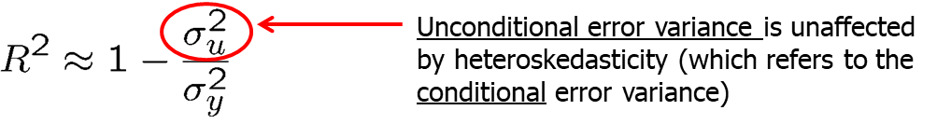
Heteroskedasticity (1 of 18)
Consequences of heteroskedasticity for OLS
OLS still unbiased and consistent under heteroskedastictiy!
Also, interpretation of R-squared is not changed
Heteroskedasticity invalidates variance formulas for OLS estimators
The usual F tests and t tests are not valid under heteroskedasticity
Under heteroskedasticity, OLS is no longer the best linear unbiased estimator (BLUE); there may be more efficient linear estimators

Slide 3
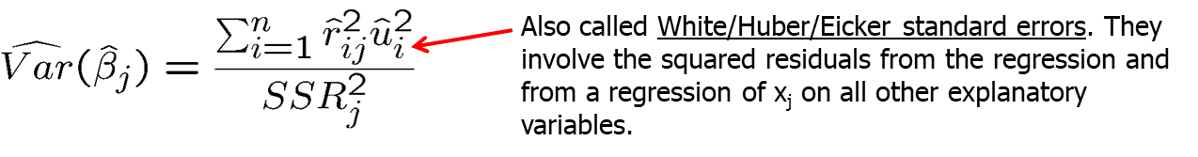
Heteroskedasticity (2 of 18)
Heteroskedasticity-robust inference after OLS estimation
Formulas for OLS standard errors and related statistics have been developed that are robust to heteroskedasticity of unknown form.
All formulas are only valid in large samples.
Formula for heteroskedasticity-robust OLS standard error.
Using these formulas, the usual t test is valid asymptotically.
The usual F statistic does not work under heteroskedasticity, but heteroskedasticity robust versions are available in most software.

Slide 4
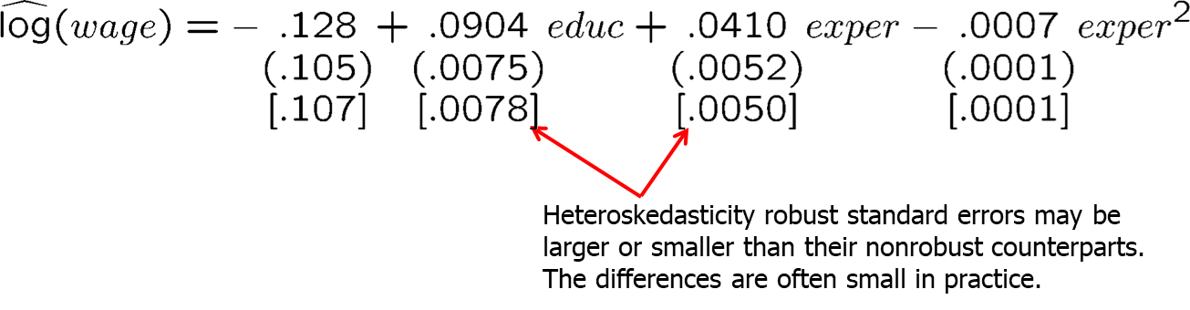
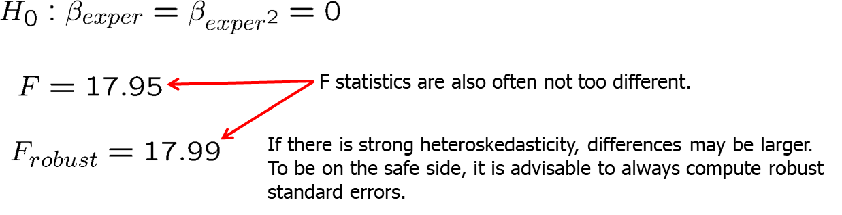
Heteroskedasticity (3 of 18)
Example: Hourly wage equation

Slide 5
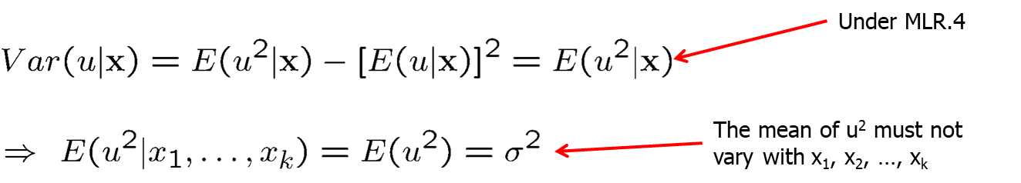
Heteroskedasticity (4 of 18)
Testing for heteroskedasticity
It may still be interesting whether there is heteroskedasticity because then OLS may not be the most efficient linear estimator anymore.
Breusch-Pagan test for heteroskedasticity

Slide 6
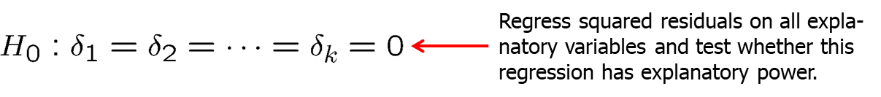
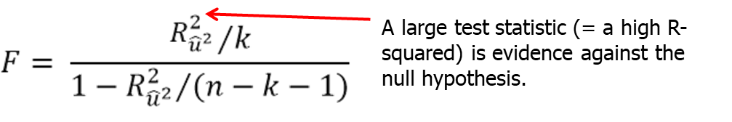
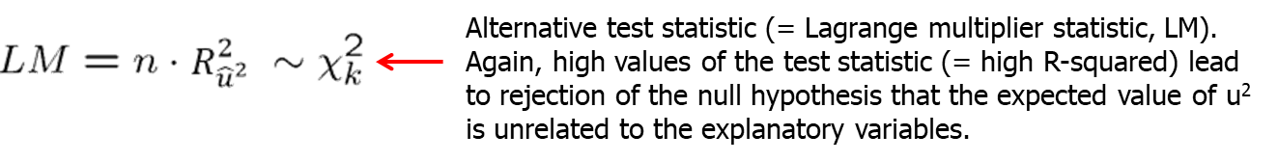
Heteroskedasticity (5 of 18)
Breusch-Pagan test for heteroskedasticity (cont.)

Slide 7
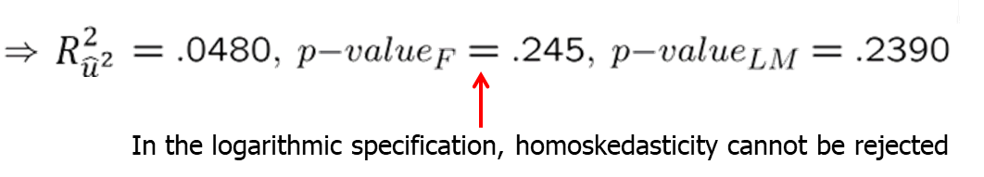
Heteroskedasticity (6 of 18)
Example: Heteroskedasticity in housing price equations

Slide 8
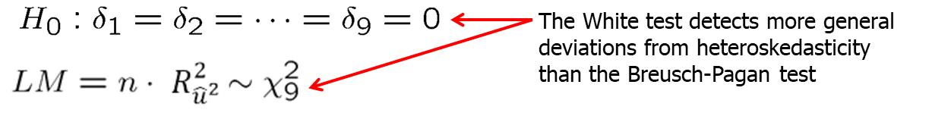
Heteroskedasticity (7 of 18)
The White test for heteroskedasticity
Disadvantage of this form of the White test
Including all squares and interactions leads to a large number of estimated parameters (e.g. k=6 leads to 27 parameters to be estimated).

Slide 9
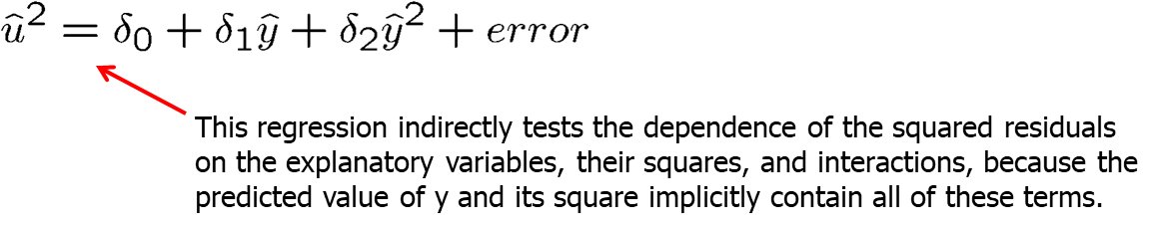
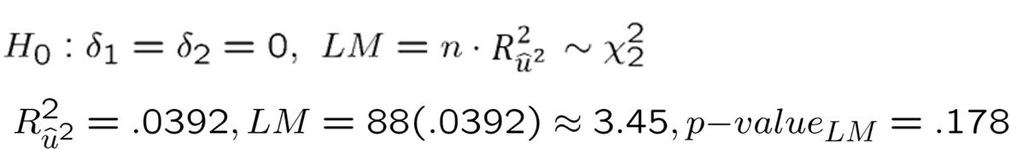
Heteroskedasticity (8 of 18)
Alternative form of the White test
Example: Heteroskedasticity in (log) housing price equations

Slide 10
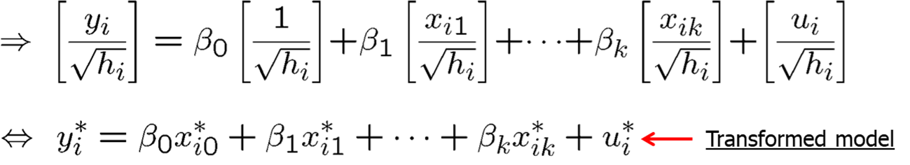
Heteroskedasticity (9 of 18)
Weighted least squares estimation
Heteroskedasticity is known up to a multiplicative constant

Slide 11
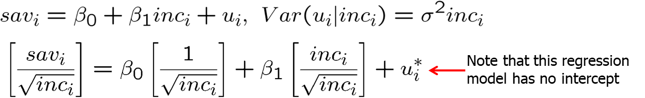
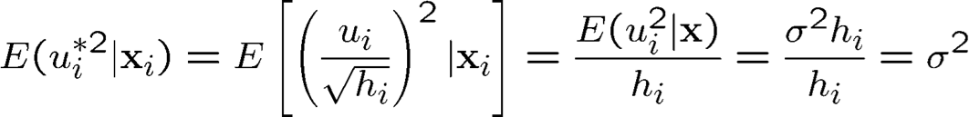
Heteroskedasticity (10 of 18)
Example: Savings and income
The transformed model is homoskedastic
If the other Gauss-Markov assumptions hold as well, OLS applied to the transformed model is the best linear unbiased estimator.

Slide 12
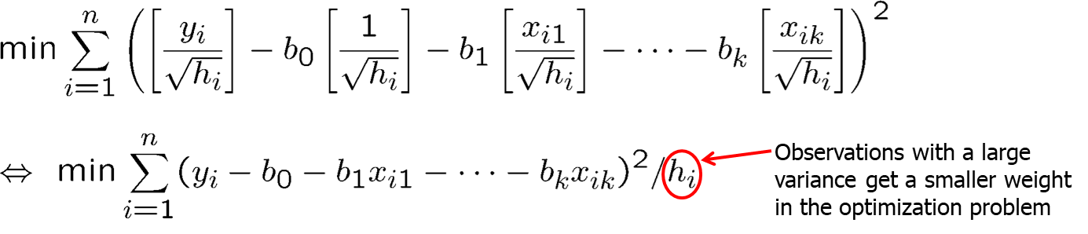
Heteroskedasticity (11 of 18)
OLS in the transformed model is weighted least squares (WLS)
Why is WLS more efficient than OLS in the original model?
Observations with a large variance are less informative than observations with small variance and therefore should get less weight.
WLS is a special case of generalized least squares (GLS)

Slide 13
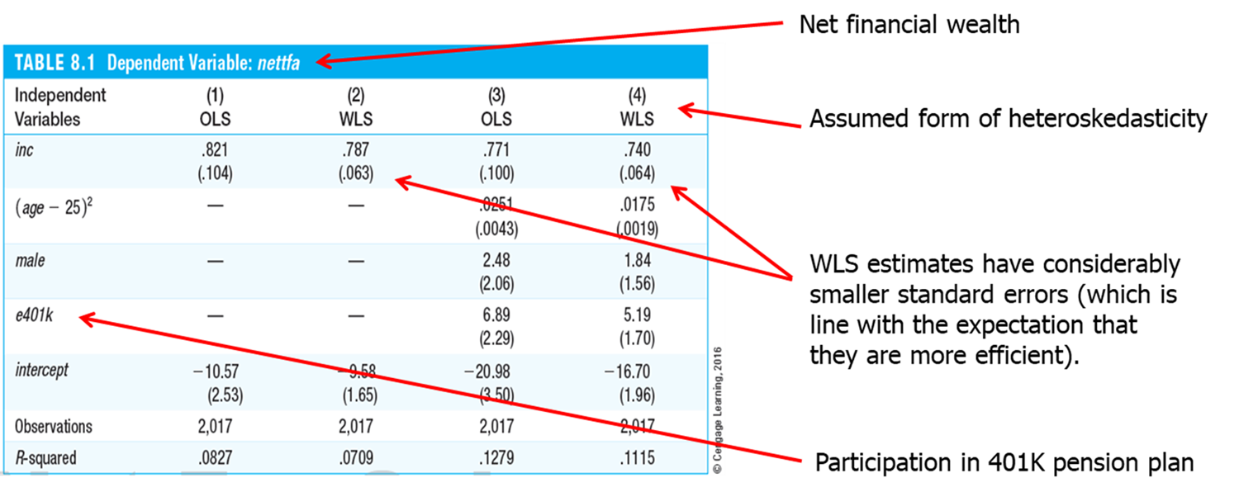
Heteroskedasticity (12 of 18)
Example: Financial wealth equation
Independent Variables | (1) OLS | (2) WLS | (3) OLS | (4) WLS
inc | .821 (.104) | .787 (.063) | .771 (.100) | .740 (.064)
(age – 25)² | - | - | .0251 (.0043) | .0175 (.0019)
male | - | - | 2.48 (2.06) | 1.84 (1.56)
e401k | - | - | 6.89 (2.29) | 5.19 (1.70)
intercept | -10.57 (2.53) | -9.58 (1.65) | -20.98 (3.50) | -16.70 (1.96)
Observations | 2,017 | 2,017 | 2,017 | 2,017
R-squared | .0827 | .0709 | .1279 | .1115

Slide 14
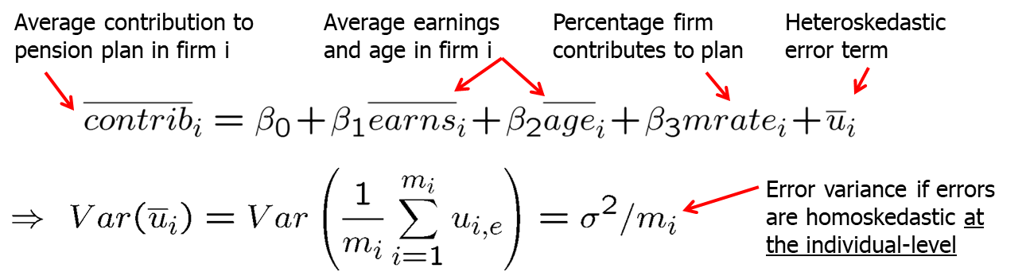
Heteroskedasticity (13 of 18)
Important special case of heteroskedasticity
If the observations are reported as averages at the city/county/state/-country/firm level, they should be weighted by the size of the unit
If errors are homoskedastic at the individual-level, WLS with weights equal to firm size m_{i} should be used. If the assumption of homoskedasticity at the individual-level is not exactly right, one can calculate robust standard errors after WLS (i.e. for the transformed model).

Slide 15
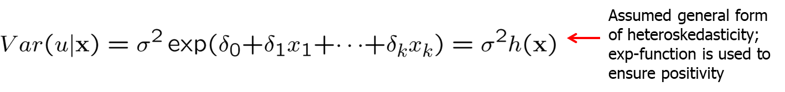
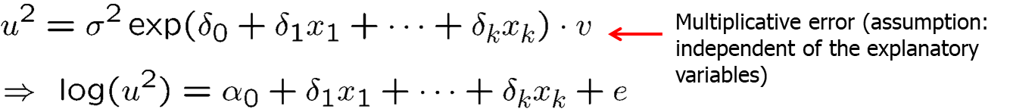
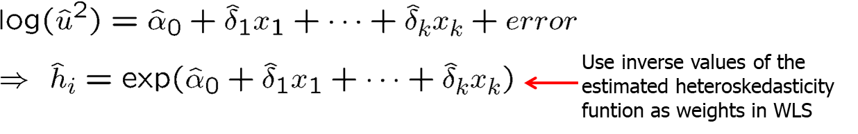
Heteroskedasticity (14 of 18)
Unknown heteroskedasticity function (feasible GLS)

Slide 16
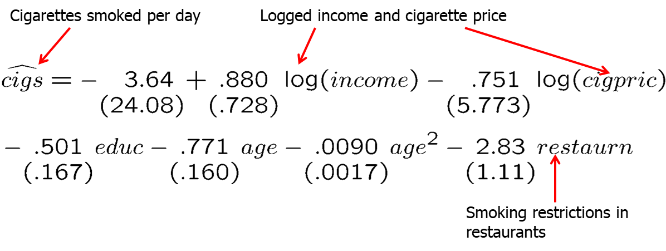
Heteroskedasticity (15 of 18)
Example: Demand for cigarettes
Estimation by OLS

Slide 17
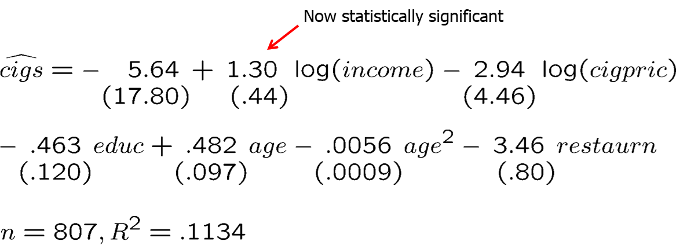
Heteroskedasticity (16 of 18)
Estimation by FGLS
Discussion
The income elasticity is now statistically significant; other coefficients are also more precisely estimated (without changing qualitative results).

Slide 18
Heteroskedasticity (17 of 18)
What if the assumed heteroskedasticity function is wrong?
If the heteroskedasticity function is misspecified, WLS is still consistent under MLR.1 – MLR.4, but robust standard errors should be computed.
WLS is consistent under MLR.4 but not necessarily under MLR.4‘
If OLS and WLS produce very different estimates, this typically indicates that some other assumptions (e.g. MLR.4) are wrong.
If there is strong heteroskedasticity, it is still often better to use a wrong form of heteroskedasticity in order to increase efficiency.

Slide 19
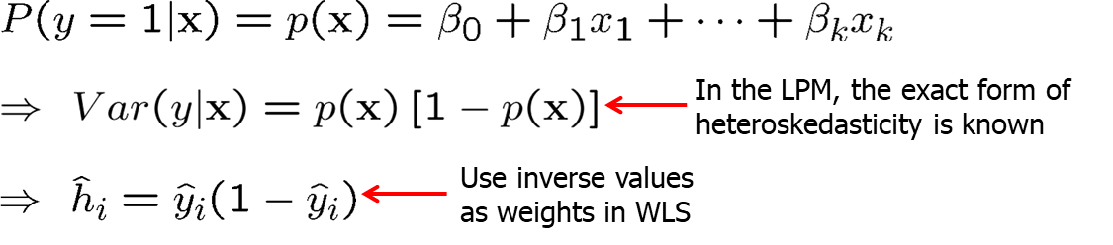
Heteroskedasticity (18 of 18)
WLS in the linear probability model
Discussion
Infeasible if LPM predictions are below zero or greater than one.
If such cases are rare, they may be adjusted to values such as .01/.99.
Otherwise, it is probably better to use OLS with robust standard errors.

